Slide 1

Reactive programming
By Petrutiu Mihai

Slide 2

About me
Dev
Know a lot of programming languages
Mainly Java/C#/JavaScript
Started to work more seriously on Python, Scala
Did a lot of architecture proposals
Worked for many clients
Have less and less time for coding

Slide 3
Presentation
What are reactive apps?
Motivation
Solution
Problems that we encountered
End advices

Slide 4
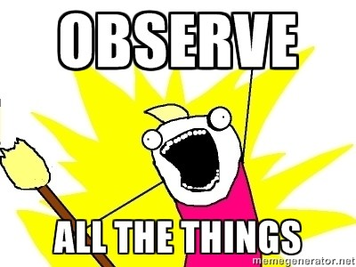
What is a reactive app?
A reactive app is an app that is build as a stream of components that react to new data

Slide 5
Presentation
What are reactive apps?
Motivation
Solution
Problems that we encountered
End advices

Slide 6
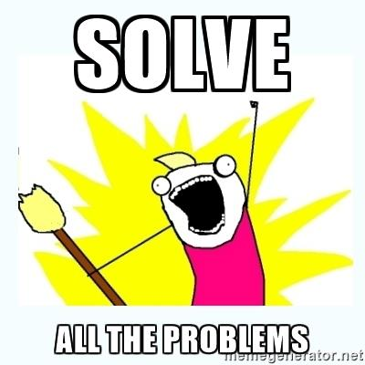
What problem do we want to solve?
Have complex apps
Easy to modify
Easy to understand
Easy to test performance
Easy to unit test

Slide 7
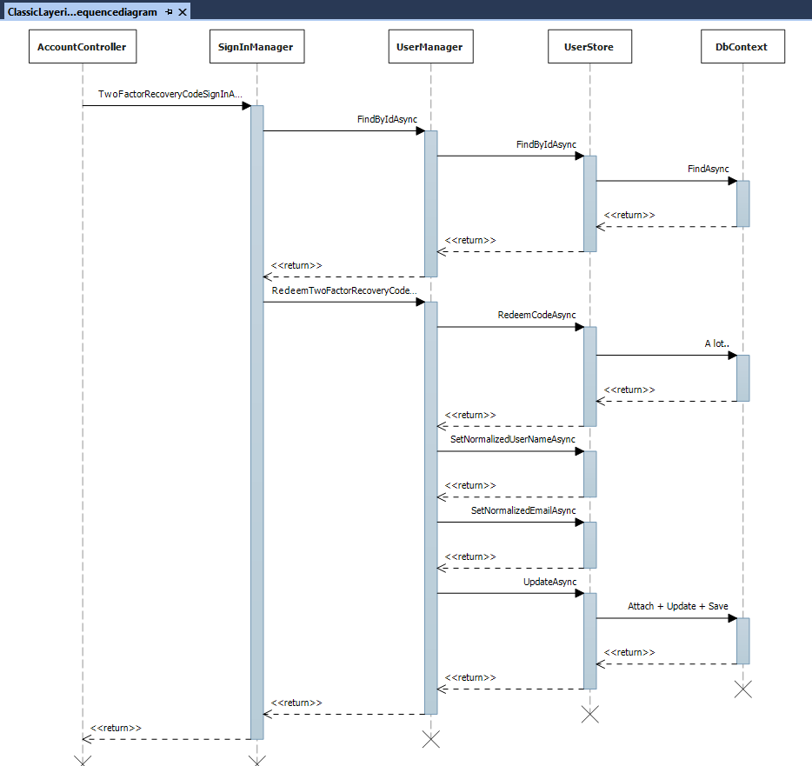

Slide 8
Class length
SignInManager – 800 lines
UserManager – 2500 lines
UserStore – 1500 lines

Slide 9
UserManager Dependencies
IUserStore<TUser> store,
IOptions<IdentityOptions> optionsAccessor,
IPasswordHasher<TUser> passwordHasher,
IEnumerable<IUserValidator<TUser>> userValidators,
IEnumerable<IPasswordValidator<TUser>> passwordValidators,
ILookupNormalizer keyNormalizer,
IdentityErrorDescriber errors,
IServiceProvider services,
ILogger<UserManager<TUser>> logger

Slide 10
Testing the application
Unit Tests
Tests on AccountController where you mock SignInManager
Tests on SignInManager where you mock UserManager
Tests on UserManager where you mock UserStore
Tests on UserStore where you mock DbContext

Slide 11
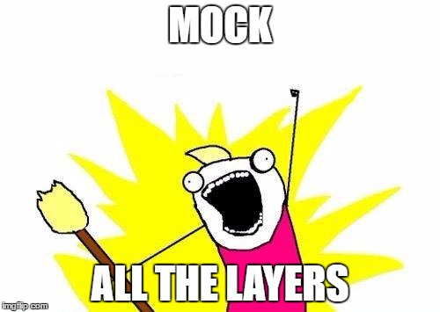
Testing the application
Every mock is an expectation
To be a successful mockist, you must dislike mocks.

Slide 12
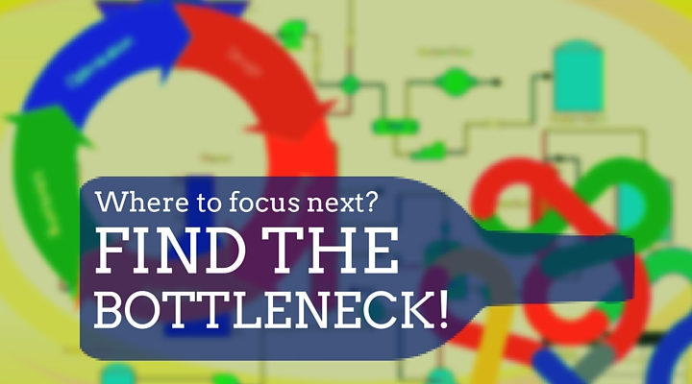
Performance testing

Slide 13
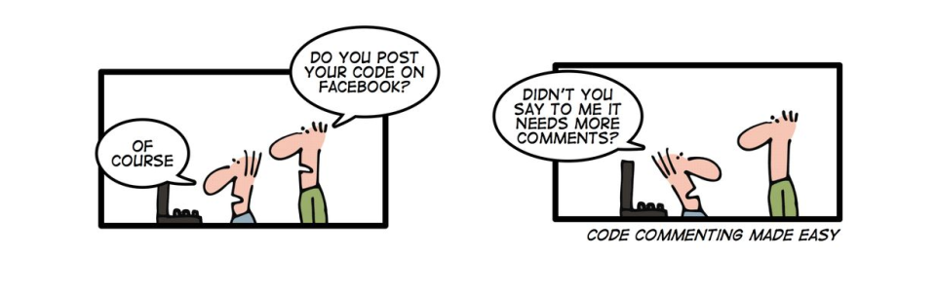
Documentation

Slide 14

What we have?
Description of some methods

Slide 15
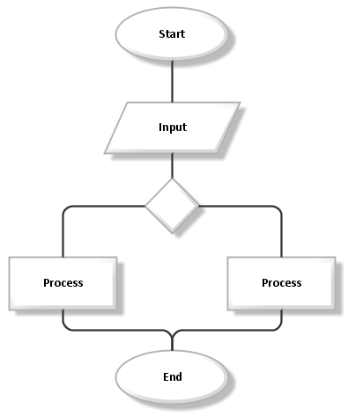
What we want?

Slide 16
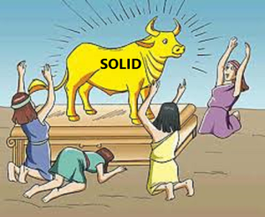
Modifying the app
Add steps without breaking open closed principle
Have no unit modified

Slide 17
Long running flows
How easy it is to write long running flows and track the progress of some requests?

Slide 18
Presentation
What are reactive apps?
Motivation
Solution
Problems that we encountered
End advices

Slide 19
Event-driven architecture (EDA)
Have the application define a clear list of commands and possible transitions between them (Declarative programming)
Have a list of commands/transitions readable through reflection so that we can document them (Declarative programming)
The transitions are done through events

Slide 20
Event-driven architecture II (EDA)
Have commands and events well known by business/QA also
Show in documentation all the possibilities that an app has through a tree

Slide 21
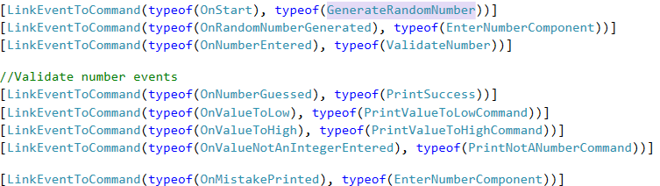
Application bootstrap

Slide 22
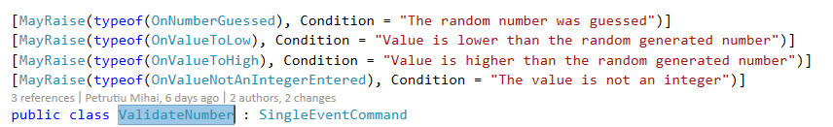

Command/Event declaration

Slide 23
Advantages (Expected)
Ubiquitous language – start talking in the terms of events and commands. (Did not happen)
Components(commands) are decoupled
Easy to extend
Easy statistics/performance Logging
Good documentation

Slide 24
Lets see code :D

Slide 25
Presentation
What are reactive apps?
Motivation
Solution
Problems that we encountered
End advices

Slide 26
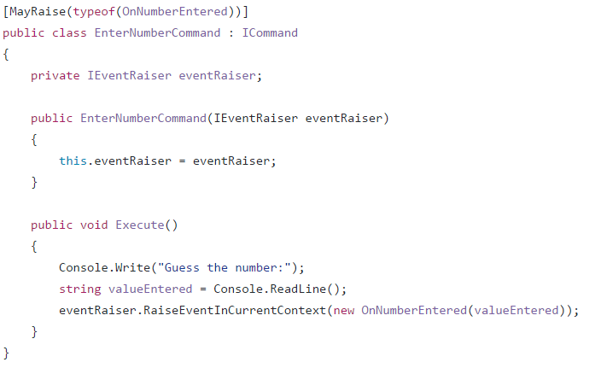
[Bad] Dependency for raising events

Slide 27
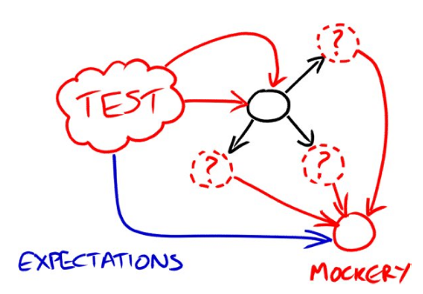
[Bad] Dependency for raising events

Slide 28
Why bad?
We should return a promise/Task/CompletableFuture from the command so that we know the command finished
Hard to unit test
Nunit/Junit are not happy with async tests
Always need to test also that we invoke it X number of times the dependency
Need to test also the data type of the event

Slide 29
[Bad] Return an Iterable/Enumerable list of events
You can see that an enumerable is done, only after you go through all of the records
In case you add new data every X minutes, you will have a thread blocked for that period waiting in a foreach
Also hard to know when the command finished work

Slide 30
[Good] Return Observables
No need for extra dependency
No thread blocked waiting for events
Observable collections can be closed, so we know we finished executing
System.Reactive has implementation in a lot of programming languages (JavaRx, RxJs, …)

Slide 31
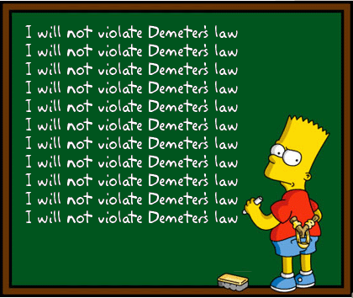
[Bad] Inject events in command constructor

Slide 32
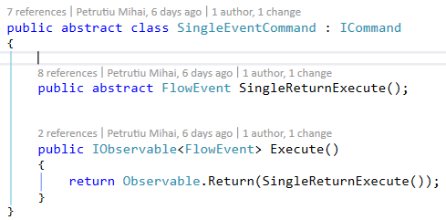
[Good] Make Helper Base commands

Slide 33
[Bad] Link only based on event’s class
You will never be able to use the command twice in the same flow

Slide 34
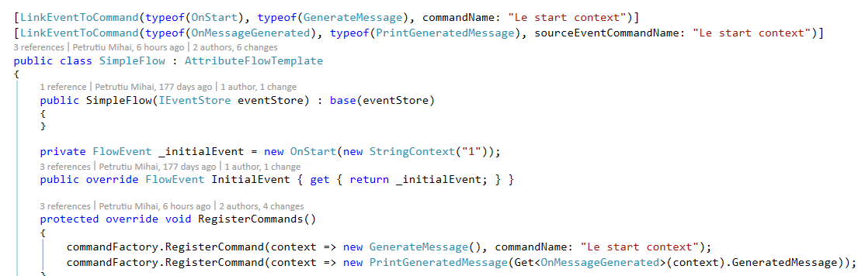
[Good] Have links based on class and name of event

Slide 35
[Bad] Copy paste links from a different flow

Slide 36
[Good] Have aggregate commands

Slide 37
Presentation
What are reactive apps?
Motivation
Solution
Problems that we encountered
End advices

Slide 38
Advices
Define
Define the relationships between commands and events using declarative programming
Prefer
Prefer returning Observables instead of invoking a method that raises events
Don’t inject
Don’t inject events directly into commands
Allow
Allow the registration of commands with specific names
Allow
Allow the creation of aggregate commands for easier reuse
Make
Make Abstract commands for specific situations (SingleEventCommand)

Slide 39
When is this useful:
Complex application
A little delay is acceptable
Async applications
High test coverage needed

Slide 40
Problems unsolved:
Sync Loops
Restrict parallelism level
Min 4 code changes for every new command
Create Command class
Create event class (one or more)
Create link between Event and Command
Register command

Slide 41
Questions?

Slide 42
Want to help?
This open source framework still needs some work
Email me at petrutiu.mihai@gmail.com
On facebook Petrutiu Mihai
On GitHub MihaiTheCoder
Project url: https://goo.gl/4D2Zkd

